Slide 1
Efficient Tools for Your Tidy Workflow
Tyson S. Barrett, PhD | JSM 2024
A case for incorporating data.table

Slide 2
But first, Who am I?
Current maintainer of
data.table
Research Manager at a large US Health Insurer
Human nerd

Slide 3
data frame: A short history
First Data.table release
Extended Data Frames with concise syntax and fast operations
First pandas release
Beginning
pandemic
Data Frames have their beginning in S
Brought Data Frames from R to Python
The start of the after-times
2000
2014
2024
1990
2009
2020
First R release
R adopted Data Frames from S
Tidyverse and friends
dplyr, tidyr, and the rest of the tidyverse comes into being, adding a structured grammar to working with Data Frames
Today
https://towardsdatascience.com/preventing-the-death-of-the-dataframe-8bca1c0f83c8
Notes:
Let’s start with a VERY brief history lesson about data frames

Slide 4
What is a data frame?
“A data frame is a list of variables of the same number of rows with unique row names… [it’s] a matrix-like structure whose columns may be of differing types (numeric, logical, factor and character and so on).“
R’s documentation for data.frame()
Notes:
At the time was groundbreaking and made so many data operations easier

Slide 5
What is a data frame?
“A data frame is a list of variables of the same number of rows with unique row names… [it’s] a matrix-like structure whose columns may be of differing types (numeric, logical, factor and character and so on).“
R’s documentation for data.frame()
Notes:
At the time was groundbreaking and made so many data operations easier

Slide 6
What is a data frame?
Do stuff to rows
df[i, j]
Do stuff to columns
Notes:
In 2008 data.table was released to build on this, keep the good stuff, drop the bad, make it faster (both to type and to compute) – but importantly keeps a similar syntax and feel to data frames

Slide 7
data.table
Philosophy: Built on data frames; keep the good stuff, drop the bad, make it faster (both to type and to compute) while keeping a similar syntax and feel to data frames
Do stuff to rows
Group by stuff
dt[i, j, by]
And more stuff
Do stuff to columns
Notes:
At the time was groundbreaking and made so many data operations easier
In 2008 data.table was released to build on this, keep the good stuff, drop the bad, make it faster (both to type and to compute) – but importantly keeps a similar syntax and feel to data frames

Slide 8
Why ?
data.table
Philosophy: Built on data frames; keep the good stuff, drop the bad, make it faster (both to type and to compute) while keeping a similar syntax and feel to data frames
Concise syntax
Fast speed
Memory efficient
Careful API lifecycle management
Community
Feature rich

Slide 9
Why ?
data.table
dt[i, j, by]
Concise syntax
Fast speed
dt[grp == “treatment”, new := mean(x), by = id]
Memory efficient
dt[dt2, on = “id”]
Careful API lifecycle management
dt[dt2, on = “id”, roll = TRUE]
Community
dt[, .N, by = id]
Feature rich

Slide 10
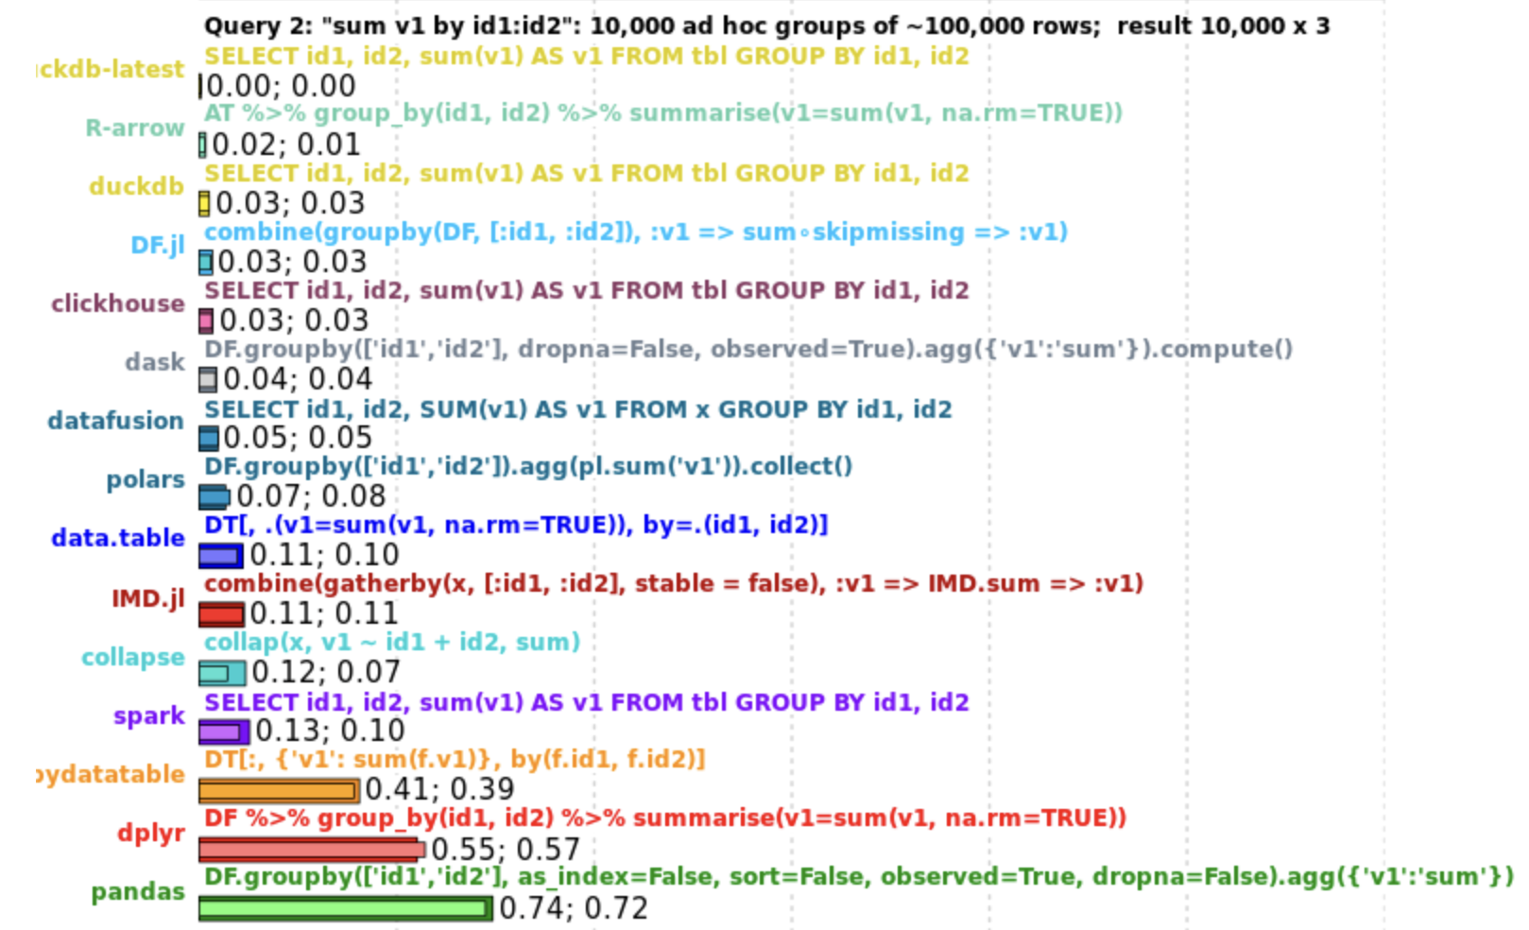
Why ?
data.table
Concise syntax
Fast speed
Memory efficient
Careful API lifecycle management
Community
Feature rich

Slide 11
Why ?
data.table
Concise syntax
Fast speed
Memory efficient
Careful API lifecycle management
Community
Still works for R version 3.3.0!
Feature rich
Notes:
Can work for a long time without breaking changes
When breaking changes are planned, communicated early

Slide 12
Why ?
data.table
Concise syntax
Fast speed
Memory efficient
Careful API lifecycle management
Community
Still works for R version 3.3.0!
Feature rich
Notes:
Can work for a long time without breaking changes
When breaking changes are planned, communicated early

Slide 13
Why say all these words to us statisticians?
data.table retains the benefits of matrices and gives you the flexibility of spreadsheets
This is ideal for statistical computing

Slide 14
New tools and
data.table
Incredible new tools (e.g., arrow, duckDB, polars) are becoming increasingly accessible, is that the death of data.table?
Open-Source Love
No! Use these powerful tools together
Notes:
These tools often use the super accessible code from dplyr too (arrow and duckDB)

Slide 15
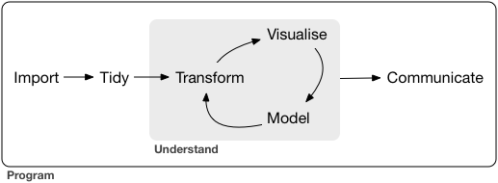
data.table
Inject into your workflow
From “R for Data Science”
data.table
can help you here
# examples are using
dt = palmerpenguins::penguins_raw
dt = janitor::clean_names(dt)
setDT(dt)

Slide 16
Import
From “R for Data Science”
data.table
can help you here
dt = fread("path")

Slide 17
Tidy
From “R for Data Science”
data.table
can help you here
dt2 = melt(
dt,
id.vars = c("study_name", "sample_number", "species"),
measure.vars = c("culmen_length_mm", "culmen_depth_mm")
)
dt3 = dcase(
dt2,
study_name + sample_number + species ~ variable,
value.var = "value"
)
Pivot longer

Slide 18
Tidy
From “R for Data Science”
data.table
can help you here
dt2 = melt(
dt,
id.vars = c("study_name", "sample_number", "species"),
measure.vars = c("culmen_length_mm", "culmen_depth_mm")
)
dt3 = dcase(
dt2,
study_name + sample_number + species ~ variable,
value.var = "value"
)
Pivot wider

Slide 19
Transform
From “R for Data Science”
data.table
can help you here
# transform a single variable
dt[, species := tolower(species)]
dt[, species := stringr::str_remove(species, "penguin.*$")]
# transform multiple columns at the same time
dt[, (names(.SD)) := lapply(.SD, fun), by = species, .SDcols = culmen_length_mm:body_mass_g]
# join with another data set
dt[penguin, on = "species")]
# rolling join
dt[penguin, on = "egg_date", roll = "nearest"]

Slide 20
Transform
From “R for Data Science”
data.table
can help you here
# transform a single variable
dt[, species := tolower(species)]
dt[, species := stringr::str_remove(species, "penguin.*$")]
# transform multiple columns at the same time
dt[, (names(.SD)) := lapply(.SD, fun), by = species, .SDcols = culmen_length_mm:body_mass_g]
# join with another data set
dt[penguin, on = "species")]
# rolling join
dt[penguin, on = "egg_date", roll = "nearest"]

Slide 21
Transform
From “R for Data Science”
data.table
can help you here
# transform a single variable
dt[, species := tolower(species)]
dt[, species := stringr::str_remove(species, "penguin.*$")]
# transform multiple columns at the same time
dt[, (names(.SD)) := lapply(.SD, fun), by = species, .SDcols = culmen_length_mm:body_mass_g]
# join with another data set
dt[penguin, on = "species")]
# rolling join
dt[penguin, on = "egg_date", roll = "nearest"]

Slide 22
Visualize
From “R for Data Science”
data.table
can help you here
# can create a bunch of plots by grouping variables
dt[,
print(
ggplot(...)
),
by = grp
]

Slide 23
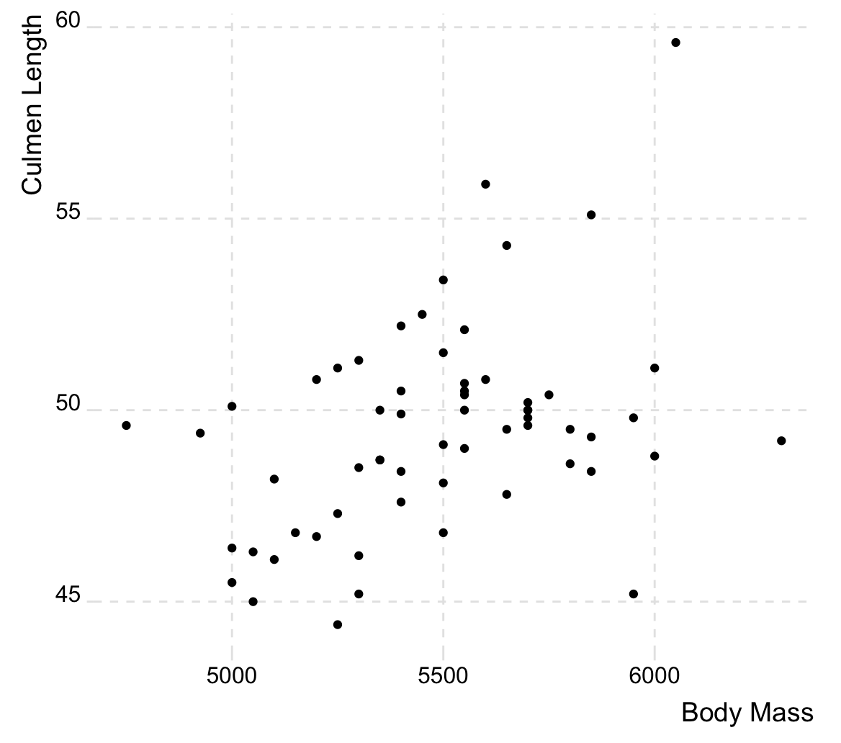
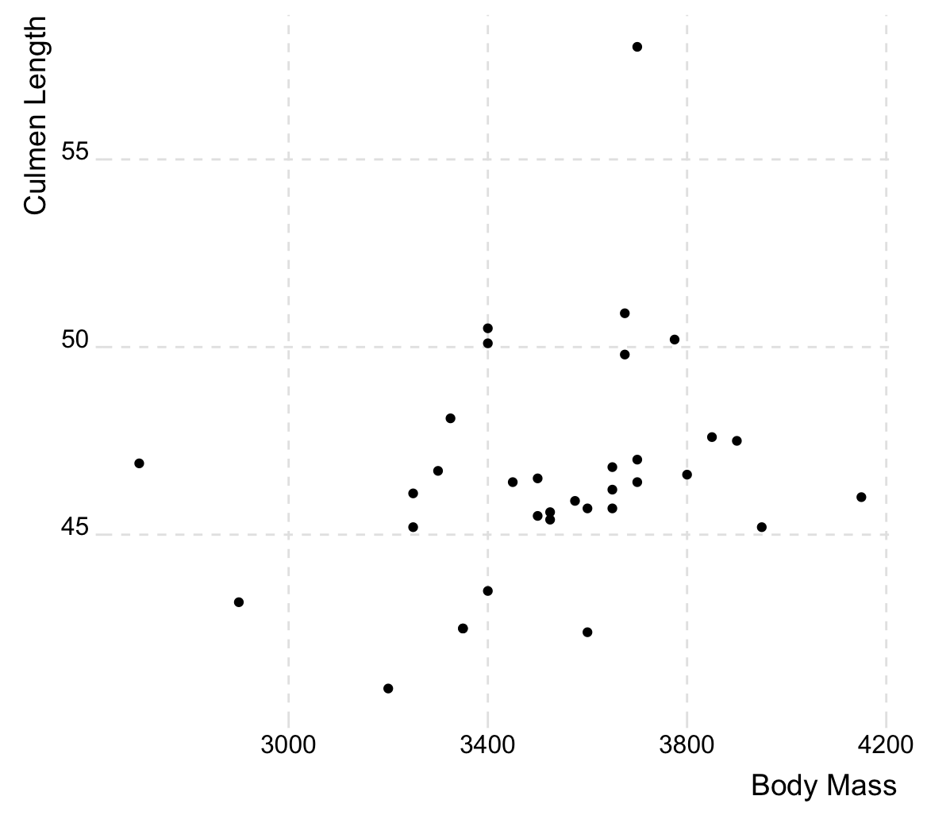
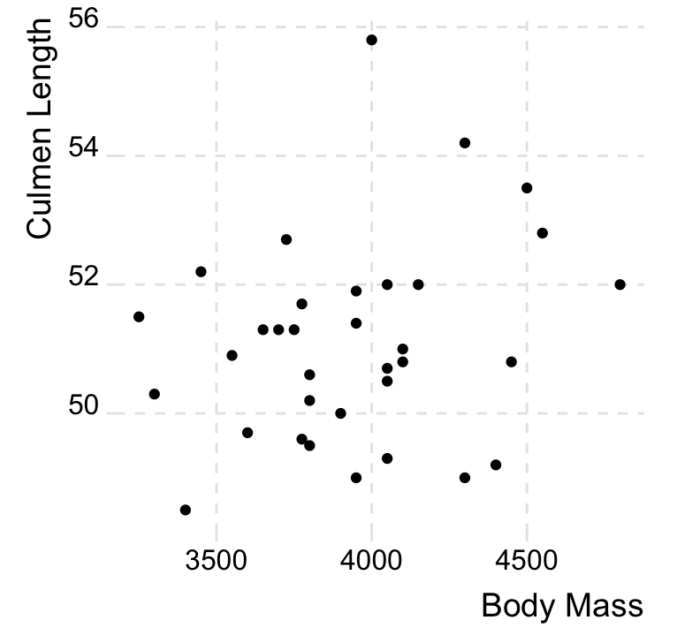
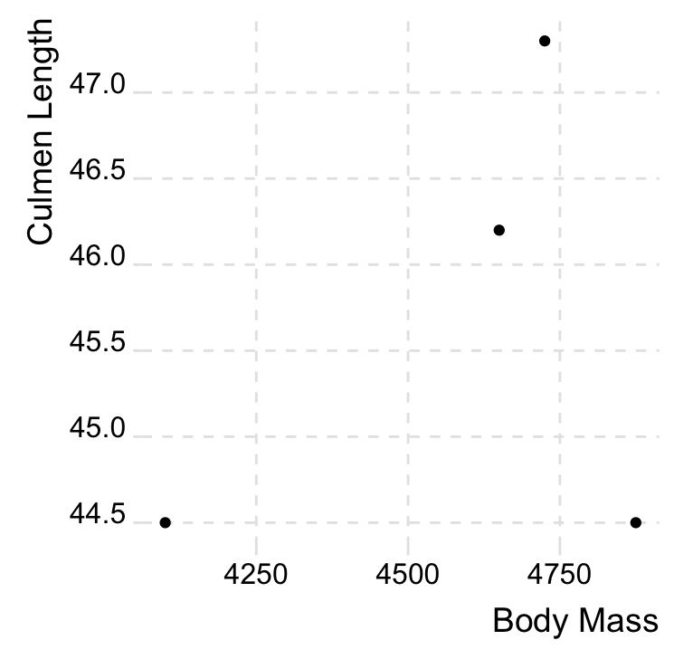
Visualize
From “R for Data Science”
data.table
can help you here
# make lots of ggplots by grouping variable(s)
dt[,
print(
ggplot(.SD, aes(x = body_mass_g, y = culmen_length_mm)) +
geom_point() +
ggridges::theme_ridges() +
theme(panel.grid = element_line(linetype = "dashed")) +
labs(x = "Body Mass", y = "Culmen Length")
),
by = .(species, sex)
]

Slide 24
Model
From “R for Data Science”
data.table
can help you here
mod_fun <- function(data){
lm(culmen_length_mm ~ body_mass_g, data = data)
}
dt[, .(mods = list(mod_fun(.SD))), by = species]
# species mods
# <char> <list>
# 1: adelie <lm[13]>
# 2: gentoo <lm[13]>
# 3: chinstrap <lm[12]>

Slide 25
It takes a village
I often use parquet files and turn set the data frame as a DT
dt = arrow::read_parquet("path") # palmerpenguins::penguins_raw
setDT(dt)
Several helper packages make a number of other facets of a tidy workflow easier
janitor::clean_names(dt) # clean those horrible names
janitor::remove_empty(dt) # drop empty columns and rows (happens in excel files a lot)
tidyfast::dt_fill() # data.table implementation of tidyr::fill()
stringr::str_replace(dt, ...) # replace strings (and a bunch of other nice string functions)
forcats::fct_inorder(fct_var) # get factors into good form for visuals
...
Quarto and friends for easy output
Make your cleaned data beautiful
library(gtsummary) # and officer and friends
library(ggplot2) # and friends

Slide 26
Tyson S. Barrett
Thanks to Matt Dowle, Arun Srinivasan, Michael Cherico, Jan Gorecki, Toby Hocking and the data.table team!
t.barrett88@gmail.com
tysonbarrett.com
@healthandstats
github.com/tysonstanley
Slides will be on my website to download

